Slide 1
SYSTEM MODELING AND PROTOTYPE Phase III
Prepared by Elementary Engineers:
Olga Sheehan, Sara Hakkoum,
Eric Holm, Ethan Fiero
Framingham State University
14 April 2016

Slide 2
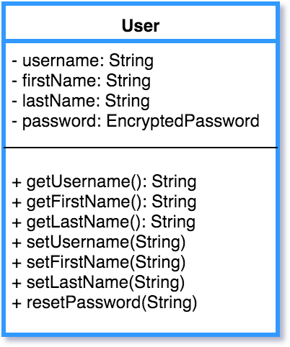
USER

Slide 3
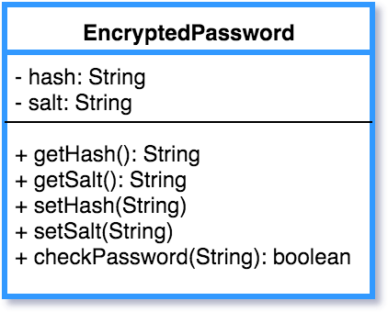
ENCRYPTED PASSWORD

Slide 4
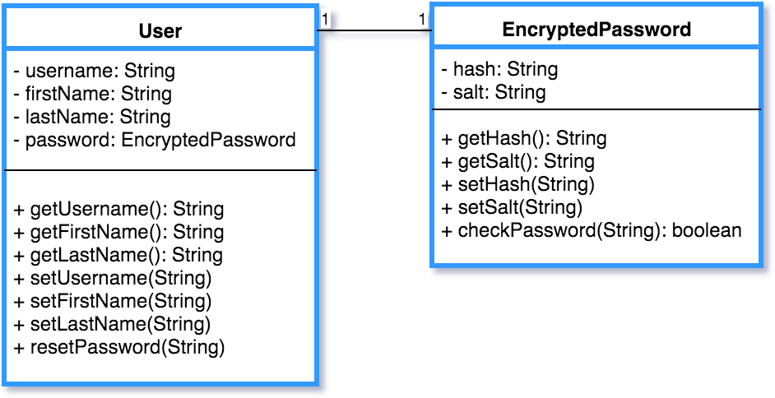
Relationship Class Diagram

Slide 5
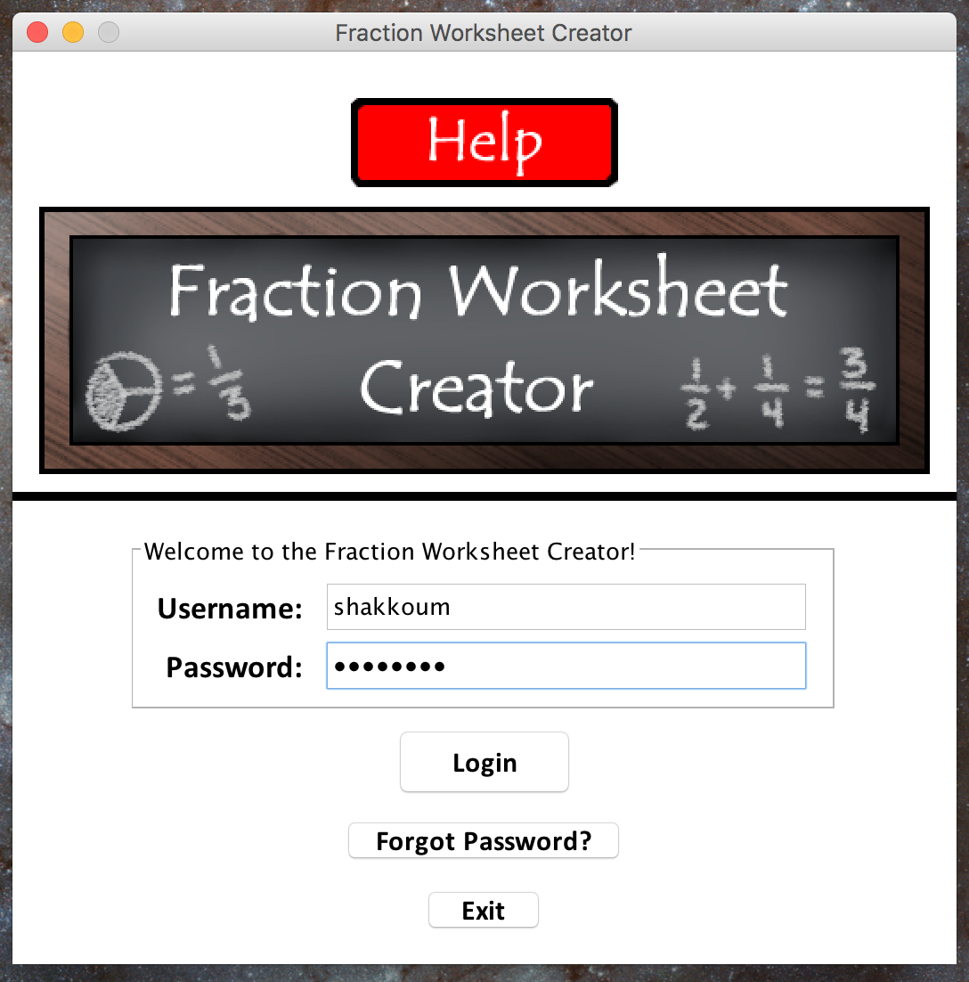
Teacher/User Login Profile

Slide 6
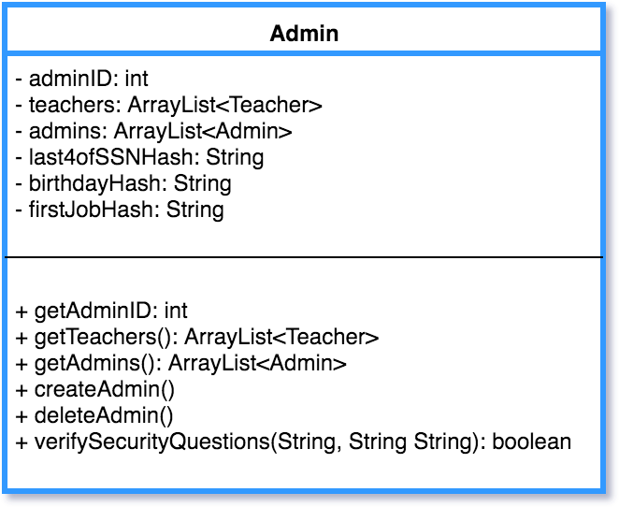
ADMIN

Slide 7
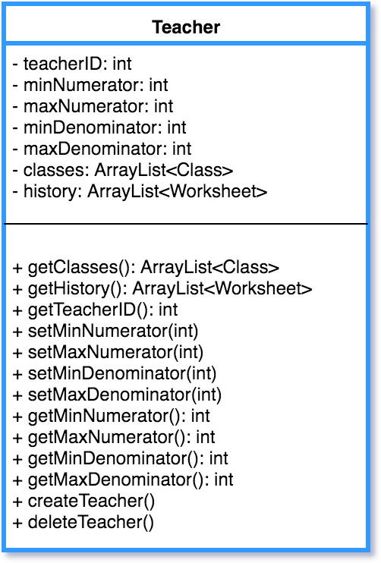
TEACHER

Slide 8
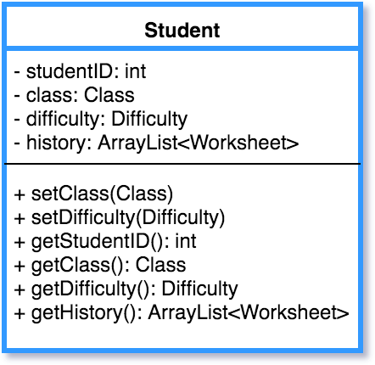
STUDENT

Slide 9
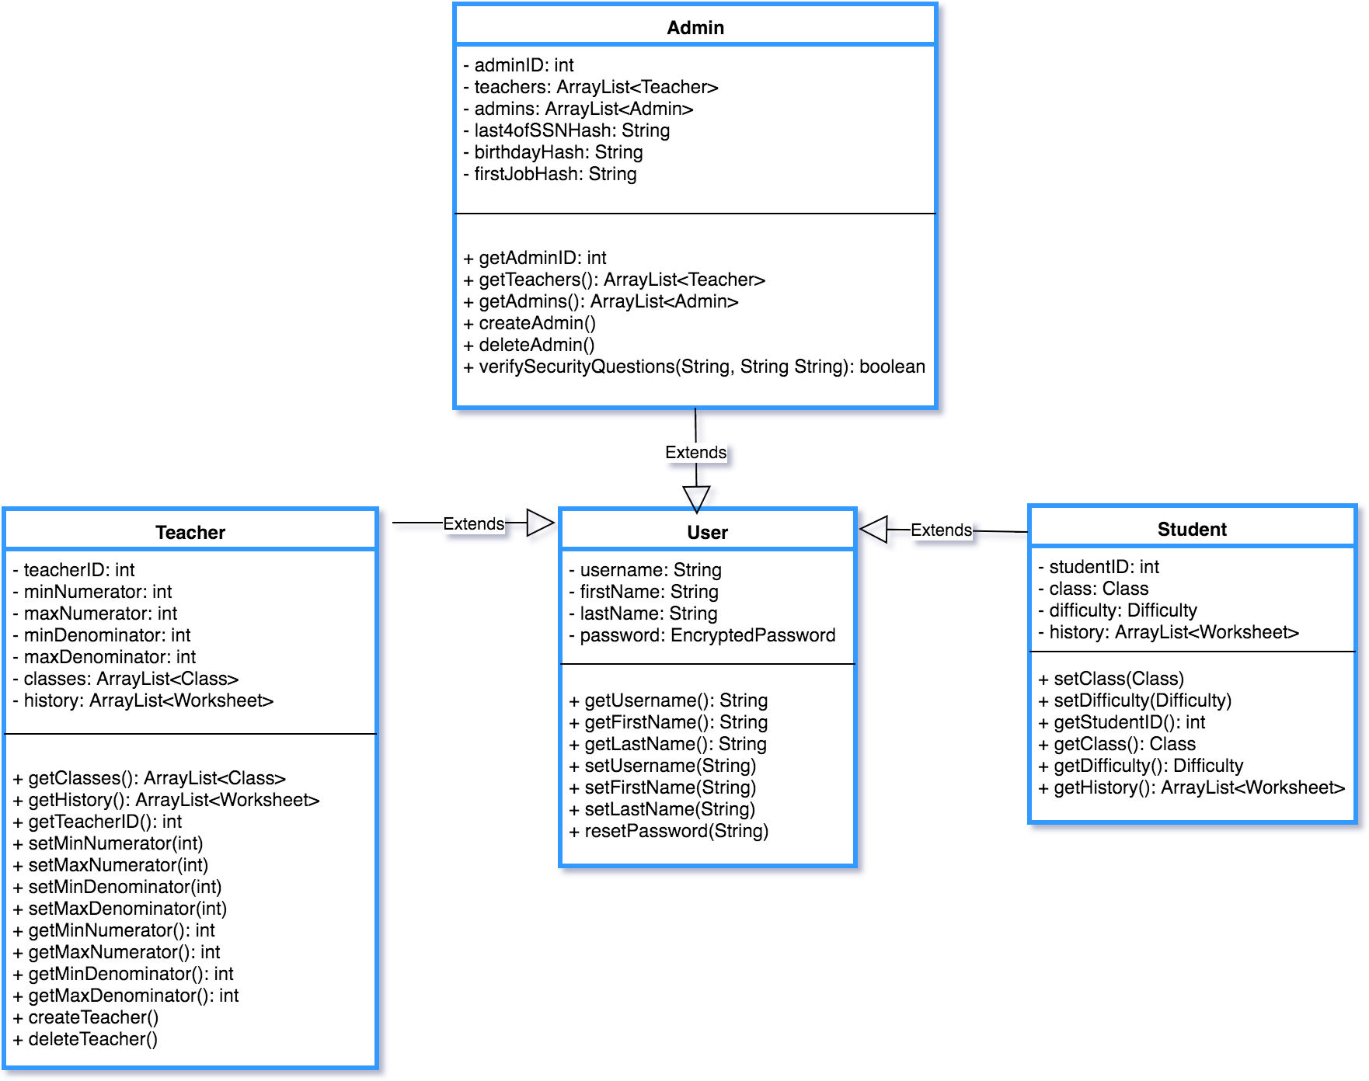
Relationship Class Diagram

Slide 10
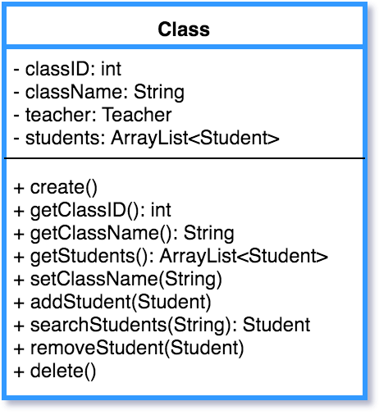
CLASS

Slide 11
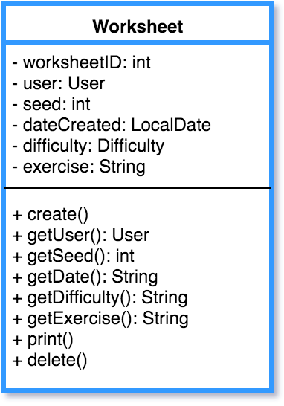
WORKSHEET

Slide 12
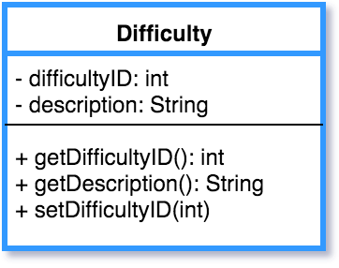
DIFFICULTY

Slide 13
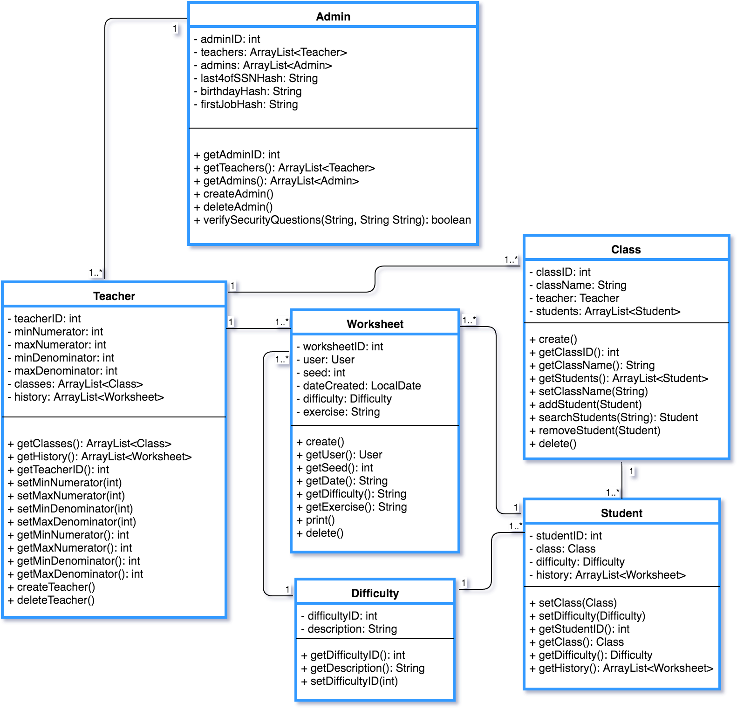
Relationship Class Diagram

Slide 14
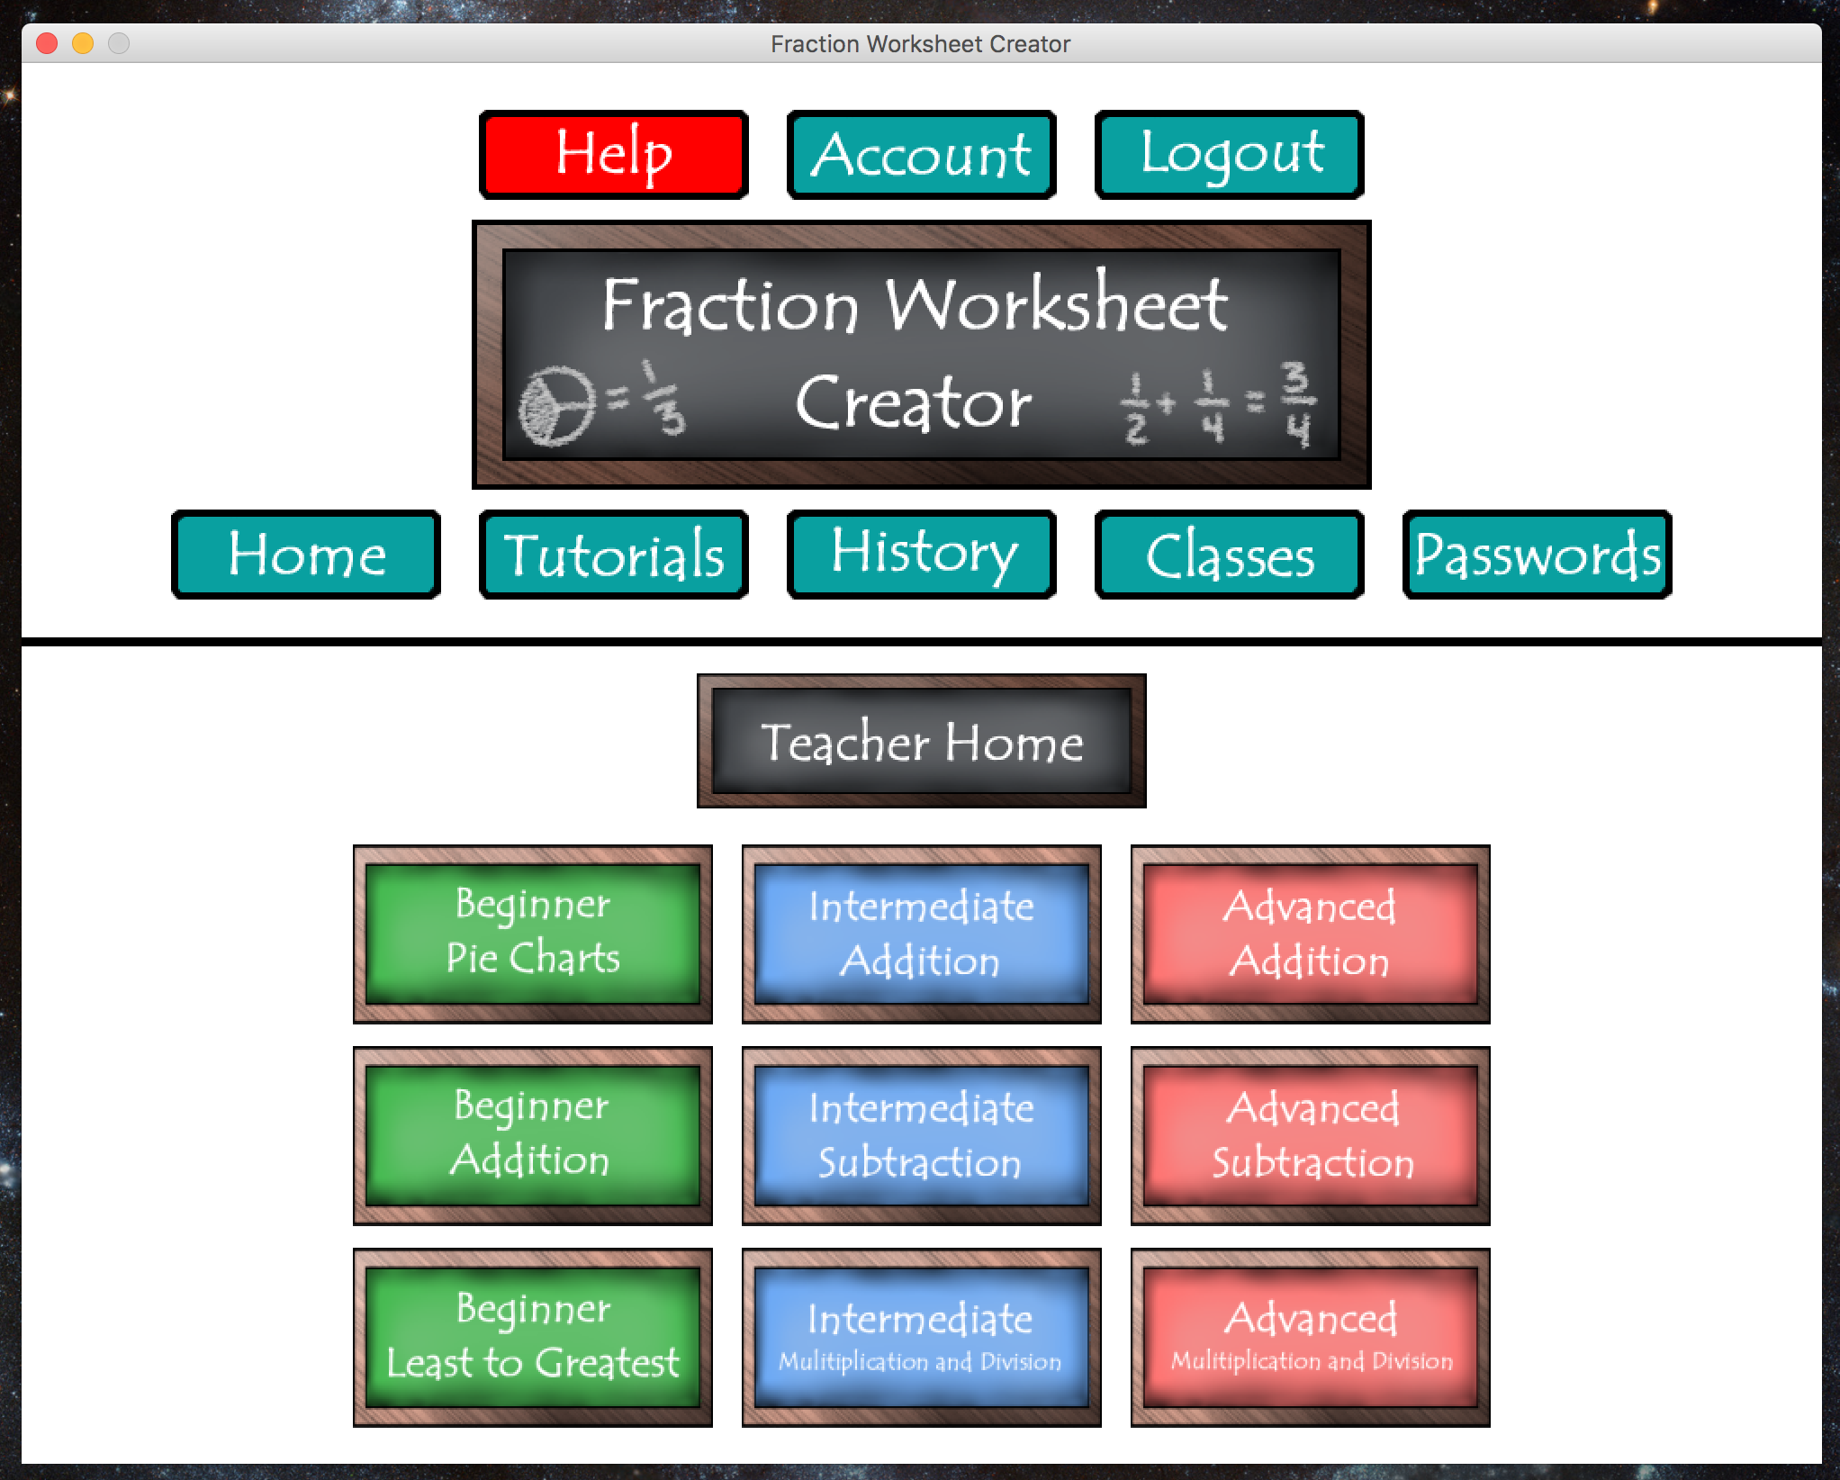
TEACHER HOME PAGE

Slide 15
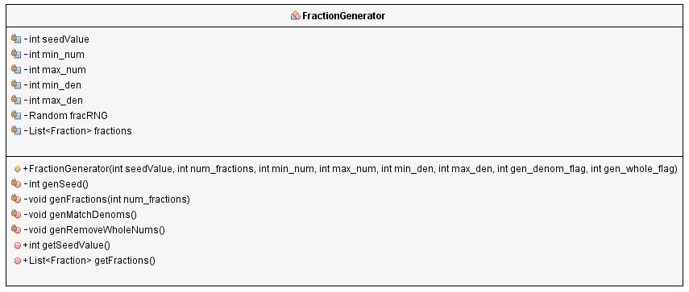
FRACTION GENERATOR

Slide 16
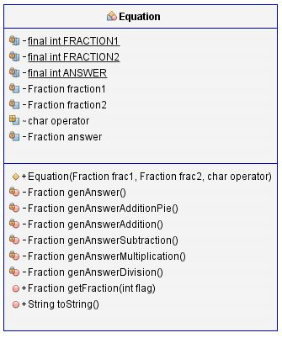
EQUATION

Slide 17
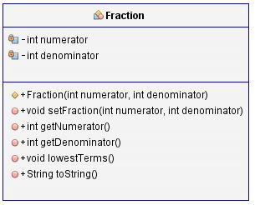
FRACTION

Slide 18
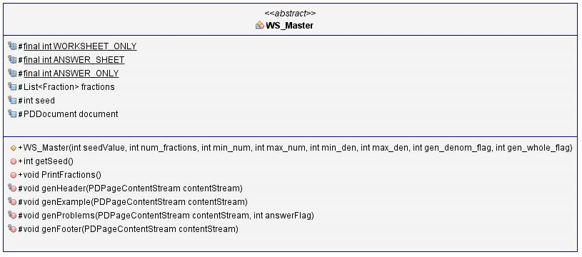
Worksheet Master (WS_Master)

Slide 19
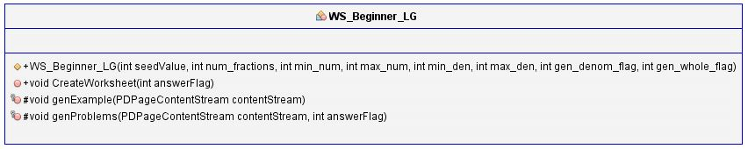
Worksheets Beginner Least to Greatest Problems (WS_Beginner_LG)

Slide 20
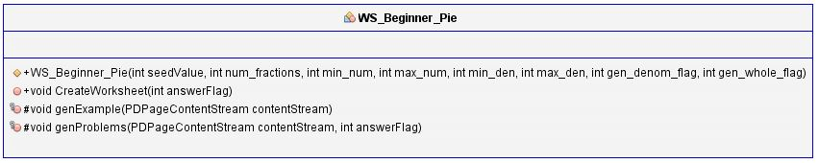
Worksheets Beginner Pie Diagram to Fraction Problem (WS_Beginner_Pie)

Slide 21
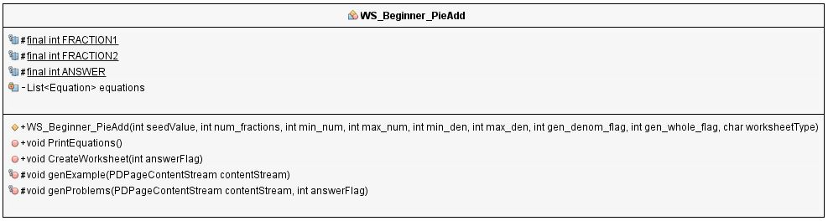
Worksheets Beginner Pie Diagram Addition Problems (WS_Beginner_PieAdd)

Slide 22
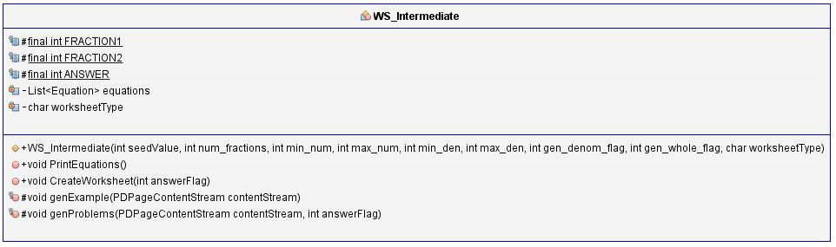
Worksheets Intermediate (WS_Intermediate)

Slide 23
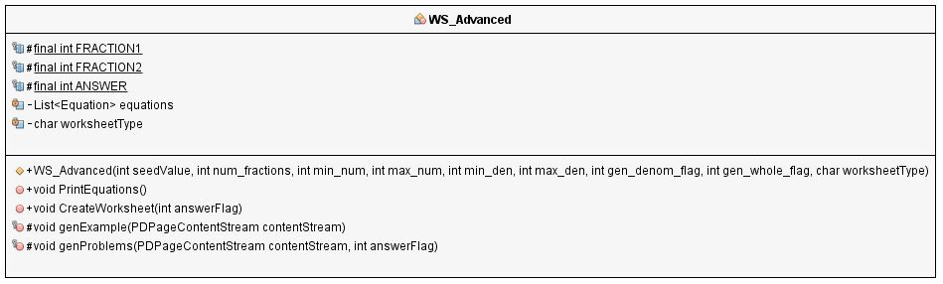
Worksheets Advanced (WS_Advanced)

Slide 24
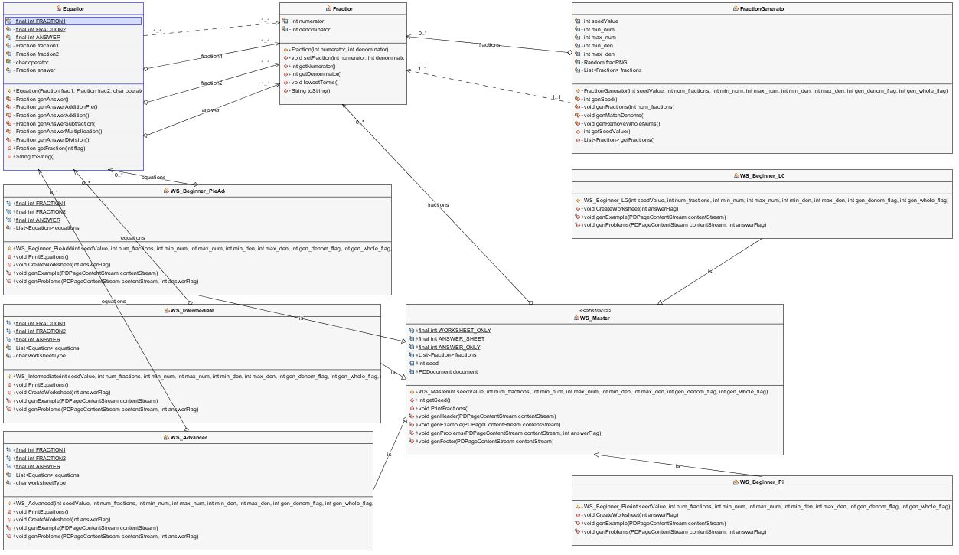
Relationship Class Diagram

Slide 25
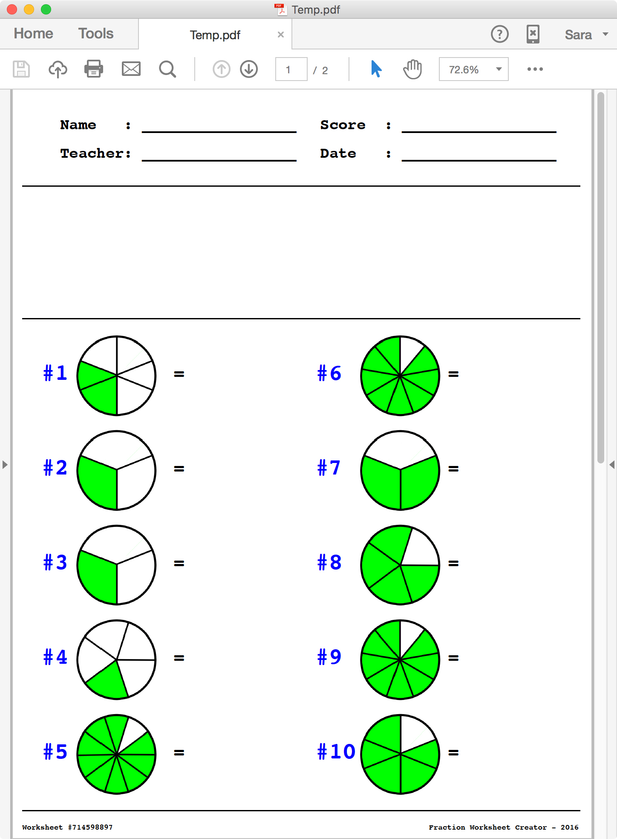
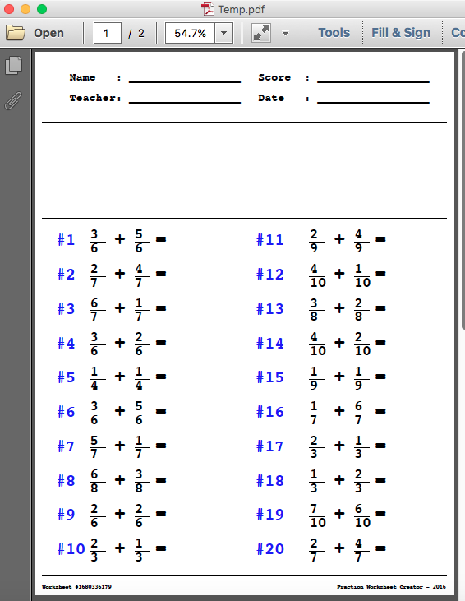
Worksheets Examples

Slide 26
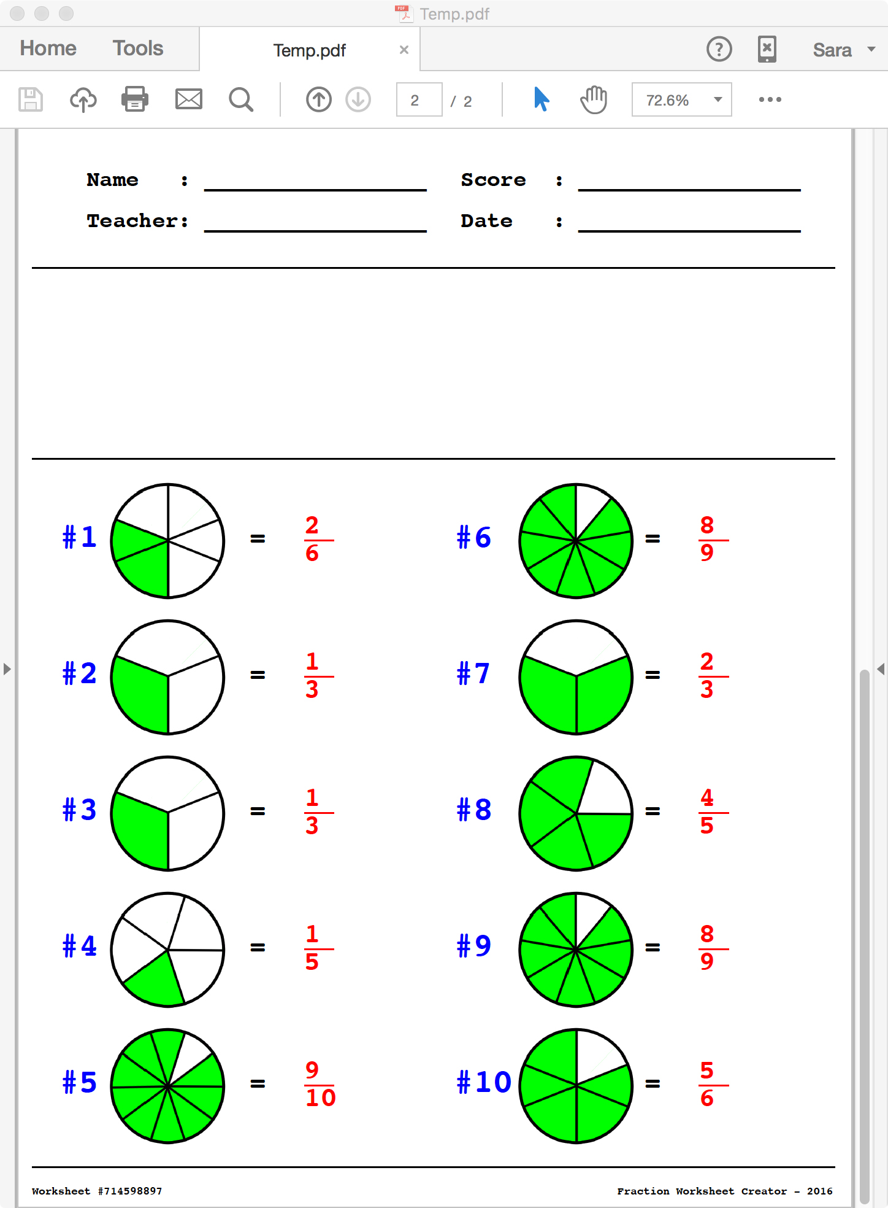
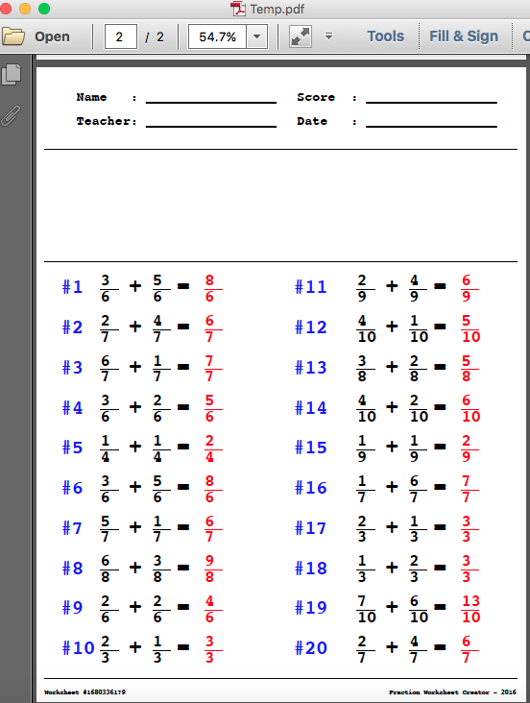
Answer Worksheets Examples

Slide 27
Demo Fraction Worksheet Creator

Slide 28
Questions?

